Slide 1
Searching
Chapter 5

Slide 2
Outline
Introduction
Linear search
Binary Search

Slide 3
Searching
Useful for many applications
Databases, editors, accounting, etc.
When searching a list of records, we are searching by KEY
Recall: key = special attribute of each record just for the purpose of sorting/searching

Slide 4
Searching
Searching can be done on unsorted or sorted data
Many search techniques exist: we will consider 3:
linear search (on both unsorted and sorted arrays or linked lists)
binary search (on only sorted arrays)
hash tables (Next Lecture)

Slide 5
Linear Search
Known as sequential search
Data may be sorted or unsorted
unsorted and sorted arrays or linked lists
Very simple algorithm (assume searching for key K):
It runs in O(n) time (i.e., linear time) since every element is inspected in the worst case.
Searching a linked list is much the same, just moving down the links instead of incrementing a counter
for (i=0; i<n; i++)
{
if (array[i] == K) return i;
}
return -1; // i.e. not found

Slide 6
Linear Search-Example
Apply the Linear Search algorithm to find the key value: 15
Highlight all elements you visited during the search process
i
Indices
6 | 5 | 4 | 3 | 2 | 1 | 0
20 | 15 | 14 | 11 | 8 | 3 | 1
Start from the first index until finding the key value
i = 0
Key is found
Search ends
Six elements have been searched

Slide 7
Exercise
Write the search algorithm for linked list.

Slide 8
Binary Search
Takes advantage of knowledge that array is sorted
Algorithm:
Set low = 0 and high = n−1
Compare the target value to the median candidate mid = ⌊(low+high)/2⌋
We consider three cases:
If the target equals the median candidate, then we have found the item we are looking for, and the search terminates successfully.
If the target is less than the median candidate, then we recur on the first half of the sequence, that is, on the interval of indices from low to mid−1.
If the target is greater than the median candidate, then we recur on the second half of the sequence, that is, on the interval of indices from mid+1 to high.
An unsuccessful search occurs if low > high, as the interval [low,high] is empty.

Slide 9
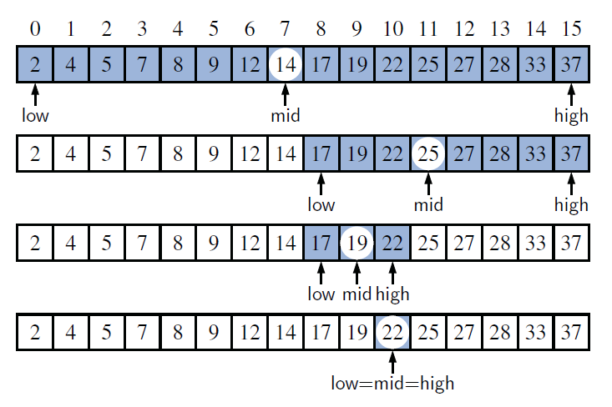
Binary Search-Example
Search for 22

Slide 10
Binary Search-Implmentation
1 /**
2 * Returns true if the target value is found in the indicated portion of the data array.
3 * This search only considers the array portion from data[low] to data[high] inclusive.
4 */
5 public static boolean binarySearch(int[ ] data, int target, int low, int high) {
6 if (low > high)
7 return false; // interval empty; no match
8 else {
9 int mid = (low + high) / 2;
10 if (target == data[mid])
11 return true; // found a match
12 else if (target < data[mid])
13 return binarySearch(data, target, low, mid − 1); // recur left of the middle
14 else
15 return binarySearch(data, target, mid + 1, high); // recur right of the middle
16 }
17 }

Slide 11
Binary Search- Performance
Binary search runs in O(logn) time. This is a significant improvement comparing with sequential search.
if n is 1 billion, log n is only 30
Much faster than linear search of sorted arrays

Slide 12
Binary Search Example 1
Apply the Binary Search algorithm to find the key value : 15
Highlight all elements you visited during the search process
low
high
Cycle 1 Starts
low = 0, high= 6, mid: 3
6 | 5 | 4 | 3 | 2 | 1 | 0
20 | 15 | 14 | 11 | 8 | 3 | 1
low
high
Cycle 2 Starts
low = 4, high = 6, mid: 5
6 | 5 | 4 | 3 | 2 | 1 | 0
20 | 15 | 14 | 11 | 8 | 3 | 1
Key is found
Search ends
Two elements have been searched
Note the difference between the Binary search and Linear search algorithms in terms of time complexity

Slide 13
Binary Search Example 2
Apply the Binary Search algorithm to find the key value : 10
Highlight all elements you visited during the search process
low
high
Cycle 1 Starts
low = 0, high = 7, mid: 3
7 | 6 | 5 | 4 | 3 | 2 | 1 | 0
100 | 91 | 80 | 66 | 52 | 35 | 20 | 10
low
high
Cycle 2 Starts
low= 0, high= 2, mid: 1
7 | 6 | 5 | 4 | 3 | 2 | 1 | 0
100 | 91 | 80 | 66 | 52 | 35 | 20 | 10
low
high
Cycle 3 Starts
low = 0, high = 0, mid: 0
7 | 6 | 5 | 4 | 3 | 2 | 1 | 0
100 | 91 | 80 | 66 | 52 | 35 | 20 | 10
Key is found
Search ends

Slide 14
Binary Search Example 3
Apply the Binary Search algorithm to find the key value : 50
Highlight all elements you visited during the search process
low
high
Cycle 1 Starts
low = 0, high = 8, mid: 4
indices
8 | 7 | 6 | 5 | 4 | 3 | 2 | 1 | 0
110 | 100 | 95 | 80 | 75 | 70 | 50 | 40 | 30
low
high
Cycle 2 Starts
low = 0, high = 3, Mid: 1
indices
8 | 7 | 6 | 5 | 4 | 3 | 2 | 1 | 0
110 | 100 | 95 | 80 | 75 | 70 | 50 | 40 | 30
low
high
Cycle 3 Starts
low= 2, high = 3, mid: 2
indices
8 | 7 | 6 | 5 | 4 | 3 | 2 | 1 | 0
110 | 100 | 95 | 80 | 75 | 70 | 50 | 40 | 30
Key is found
Search ends

Slide 15
Binary Search Example 4
Apply the Binary Search algorithm to find the key value : 55
Highlight all elements you visited during the search process
low
high
7 | 6 | 5 | 4 | 3 | 2 | 1 | 0
53 | 50 | 22 | 18 | 15 | 12 | 8 | 4
No elements will be searched because the value is out of range
Before you call the binarySearch on slide 10 you should make sure that the key is within the range

Slide 16
Binary Search Example 5
Apply the Binary Search algorithm to find the key value : 224
Highlight all elements you visited during the search process
low
high
Cycle 1 Starts
low = 0, high = 6, mid: 3
6 | 5 | 4 | 3 | 2 | 1 | 0
250 | 222 | 208 | 155 | 120 | 80 | 40
Cycle 2 Starts
low= 4, high = 6, mid: 5
low
high
6 | 5 | 4 | 3 | 2 | 1 | 0
250 | 222 | 208 | 155 | 120 | 80 | 40
Cycle 3 Starts
low = 6, high = 6, mid: 6
low
high
Ends the loop and search because
low = 6, high = 5
6 | 5 | 4 | 3 | 2 | 1 | 0
250 | 222 | 208 | 155 | 120 | 80 | 40
Key is not found
Search ends

